Slide 1
Web Programming with Servlets & JSP
ASSIGNMENT GUIDELINE

Slide 2
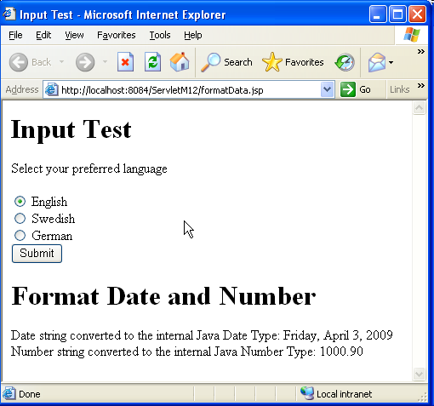
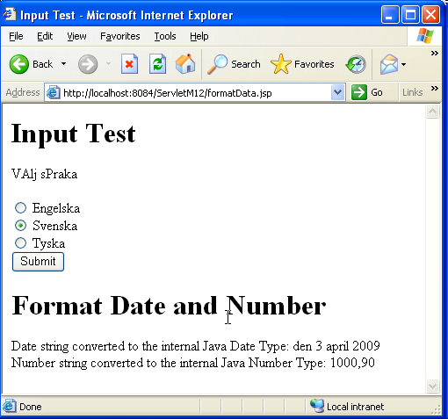
Assignment Guideline 12_1
Creating the I18N in Servlets as the above image using Servlets
Should reference the steps in Workshop. However, convert the reference code to the servlet

Slide 3
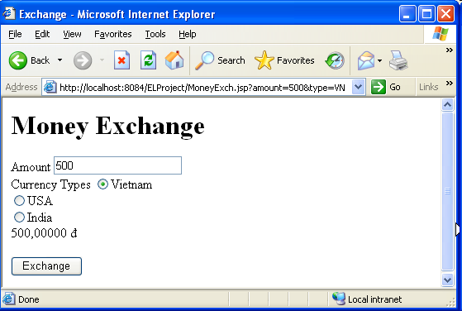
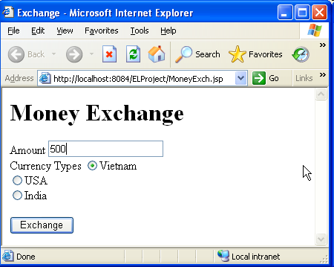

Assignment Guideline 12_2
Creating the JSP page using
  I18N and formatting Tag library to do the exercise (using format setLocale, formatNumer and Decision making tag library to present the result)

